Slide 1
Missouri Cancer Registry and Research Center
Department of Public Health
The ultimate goal of collecting
cancer information is to prevent and control
cancer and improve patient care.

Slide 2
MCR Soup: Ingredients to Quality Data
Department of Public Health
College of Health Sciences
Presented by Lucinda Ham, RHIA, ODS-C, QA/Operations Manager, Deborah Carey, ODS-C, Babette Langeneckert, ODS-C
Missouri Cancer Registry and Research Center
October 4, 2024

Slide 3
Acknowledgements
Missouri Cancer Registry and Research Center is housed on the campus of the University of Missouri in Columbia, Missouri. The Missouri Cancer Registry and Research Center (MCR-ARC) is supported in part by a cooperative agreement between the Centers for Disease Control and Prevention (CDC) and the Missouri Department of Health and Senior Services (DHSS) (NU58DP007130-02) and a surveillance contract between DHSS and the University of Missouri. Missouri is a Research state for SEER.
Notes:
read slide

Slide 4
MCR Certifications
2023
MCR is certified as a 2023 U.S. Cancer Statistics Registry for Surveillance and 2023 Registry of Distinction awards. The latest U.S. Cancer Statistics data — which includes all information collected in Missouri — is available through several interactive data visualization tools.
MCR is also a SEER Research state.
Notes:
MCR joined the Department of Public health under the College of Health Sciences last year. We are proud to have received the 2023 NAACCR Registry of Distinction award. In addition, MCR is certified as a 2023 US Cancer Statistics registry. The latest US cancer data, which includes all information collected in Missouri, is available through several data visualization tools which will be reviewed later in this presentation.

Slide 5
Top Ingredients for MCR Soup
Cancer Case Reporting
Quality Data
Path Lab Cases
Death Clearance Cases
Race/Demographic data
Audits
Data Collection Items
Education
Data Uses
Notes:
It takes many ingredients to make a tasty stew just as it many components are needed for a successful cancer program. We will go over some of the processes, projects and updates to contribute to MCR Soup.

Slide 6
Recipe for Success
Timeliness and Completeness NPCR Standard
24-month data
Data are 95% complete based on observed-to-expected cases computed by CDC.
There are 3% or fewer death-certificate-only cases.
There is a 1 per 1,000 or fewer unresolved duplicate rate.
The maximum percentage of missing critical data elements are—
2% Age
2% Sex
3% Race
2% County
99% pass a CDC-prescribed set of standard computerized edits.
12-month data
12-month data
No more than 5% of cases are ascertained solely on the basis of a death certificate.
No more than 3% of cases are missing information on age.
No more than 3% of cases are missing information on sex.
No more than 5% of cases are missing information on race.
At least 97% of the registry’s records pass a CDC-prescribed set of standard computerized edits
Notes:
These are the standards MCR must meet to achieve the Gold Certification. It is very important to collect accurate demographic data such as race, gender and county information. MCR performs several linkages with DHSS to try to complete this information if it is missing.

Slide 7
Timely Harvest
Power BI is MCR’s tool of choice for tracking timeliness and completeness.
Data completeness is monitored monthly
Status letters are sent to reporters several times per year which contain:
# cases submitted
# Percent completed based on past submissions
Notes:
Timeliness is like picking produce at the right time before it becomes aged. Read slide

Slide 8
Gold Certificates Awarded
MCR awarded Gold certificates for 2022 data completeness and timeliness to 19 facilities in 2024. Those recipients include:
Belton Regional Medical Center
Cass Regional Medical Center
Centerpoint Medical Center
Children’s Mercy Hospital
Citizens Memorial Hospital
Cox Health Springfield
Cox Medical Center Branson
Golden Valley Memorial Hospital
Lee’s Summit Medical Center
Mercy Hospital Joplin
Mosaic Life Care Maryville
Mosaic Life Care St. Joseph
Phelps Health
SSM Health Cardinal Glennon
SSM Health St. Clare Hospital Fenton
SSM Health St. Mary’s Hospital Jefferson City
St. Francis Medical Center Cape Girardeau
St. Luke’s Des Peres Hospital
Ste. Genevieve County Memorial Hospital
University Health Truman Medical Center
Notes:
MCR awarded 19 facilities in 2024 with Gold Certificates for providing timely and complete data. The criterion for this award includes - Reporting monthly or quarterly as required and reporting 95% of the average annual caseload by the end of the reporting period. Congratulations to you if your facility was a recipient of this award. One of the facilities listed was recognized by their facility and the ODS received the CARES award for their outstanding work. We are happy that the letters can promote the registry in a positive way!

Slide 9
MCR by the Numbers – FY2023
Measure | Result
Average file processing time | 9 days
Average # Records processed per month | 6300
Total # records processed in FY 2023 | 73,958
% to be consolidated | 1%
Average # files submitted per month | 95
Average # files processed per month | 98
Notes:
This slide shows our current files processing time from the time you submit your files to MCR. We have reduced this from an average of 23 days in 2022 to 9 days in 2024.

Slide 10
Abstracting Cases – Adding More to the Mix
MCR discontinued upgrading the Abstract Plus program at the end of 2022.
Web Plus, which is our internet-based program, is now used for low volume facility reporting.
MCR Successfully converted twenty reporters to using Web Plus for Case Abstraction.
MCR onboarded 5 Physician groups, 2 Oncology centers, and other facilities in 2023-2024.
All facilities will be required to submit cases electronically by the end of 2027.
Notes:
Read slide

Slide 11
Digging Deep for Incidence Data
All path labs must abide by the same reporting requirements as other types of health care facilities.
Path lab information is imported daily into MCR’s eMarc path lab software. Information is not equivalent to a full abstract.
MCR team has successfully imported over 700 path lab cases that were not reported otherwise by adding default data and case cleaning using Python.
Examples include:
Surveillance only prostate cases, melanoma cases, etc.
Process identifies non-reporters
Notes:
Read slide

Slide 12
Death Clearance - Cleaning Up
Process of matching registered deaths in a population against the cancer registry database
Improve registry data quality and completeness with use of official mortality files and death certificates to update cases with death information and identify previously unreported cases
Used as a measure for data quality by national standard setters (NAACCR, CDC and SEER)
Follow guidelines per the NAACCR Death Clearance Manual: Minimum Requirements and Best Practices for Conducting Death Clearance
Notes:
Stacy Barr is MCR’s Death Clearance coordinator. The process adds over 1,200 cases to our data base annually. It is very important that you process the death clearance cases when they come to you via Web Plus. Read slide

Slide 13
Death Clearance Process
Death Clearance Match: Deaths from the official state mortality file are linked to MCR database to identify records that match and those that do not match. Each patient match is updated with death and other relevant data.
Death Clearance Follow back: For records with a cancer diagnosis that did not match the MCR database at the patient level, the registry must conduct an investigation.
Contact facilities for information confirming a reportable cancer diagnosis or potential missed case that will be completed and submitted to MCR
If no information other than the death certificate is found, the case will remain in the registry data base as a Death Clearance Only (DCO) case
Notes:
Read slide

Slide 14
NPCR Standard Status Report
*NPCR National Quality Standard for percentage of death clearance only cases < 3.00
NPCR Standard Grouping | Diagnosis Year | % Death Clearance Only Cases*
National Data Quality | 2019 | 1.71
 | 2020 | 1.62
 | 2021 | 1.53
Death Clearance YouTube video available on the MCR website
Notes:
The National Quality Standard for death clearance only cases is less than 3% annually. MCR continues to meet this goal annually. MCR has a Death Clearance YouTube video available on the website which contains instructions for processing Death Clearance cases. Over time, we have gradually decreased our percent of Death Clearance cases.

Slide 15
Audits

Slide 16
Casefinding Audits
National Program for Cancer Registries (NPCR) Program Standard 1.7
At least once every 5 years, CCR conducts casefinding and re-abstracting audits from a sample of source documents for each hospital-based reporting facility.
MCR performed 7 casefinding audits in 2022-2024 to date
Only a handful of missed cases have been found!
Kudos to you for doing a great job of case finding!
Updated the audit process using medical record disease indices in Excel format for comparing data items, rather than manually reviewing data line by line.
Notes:
Read slide

Slide 17
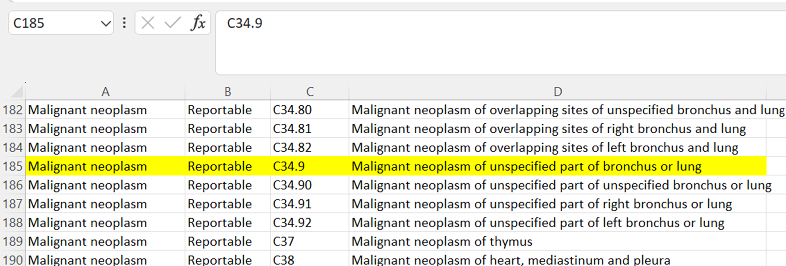
Updated Audit Process Overview
Medical Record Disease Index (MRDI) needs to be in Excel format.
The MRDI is compared to the ICD-10 Casefinding spreadsheet by using the =MATCH Excel formula.
The cases with matching codes are then compared to the CCR database.
SAMPLE

Slide 18
Updated Audit Process Overview
The comparison is completed by using the application Match*Pro provided by NCI/SEER.
Match*Pro application serves as a records linkage or matching method that compares patient identifiers between two files using probabilities to determine if the identifiers match.
Once the cases have been compared to the CCR database the non-matched cases (or potentially missed cases) are then submitted to the facility for review.
Web Plus is used to communicate with facilities.
The facility will review the cases and submit any that were truly a missed case.

Slide 19
Abstracting Resources
NAACCR
STORE
SEER
Notes:
NAACCR, STORE and SEER are the top 3 resources used by MCR and ODSs in general. If in doubt, please take the time to check your resources. Drop downs are great but may not provide a complete description of the codes and you are more likely to remember the rules if you look them up.

Slide 20
NAACCR Sources
NAACCR Resources can be found at https://www.naaccr.org/
Notes:
NAACCR has a new look to its website. The Implementation Guidelines are found in the same location. The Data Dictionary can easily be accessed by version by clicking on the icon. NAACCR recently posted the 2025 Implementation Guidelines.

Slide 21
ICD-O-3.2 Guidelines
The 2024 update includes 3 pages of new or revised terms. Standard setter columns have been added to show which codes are required for each.
https://www.naaccr.org/icdo3/
Notes:
The ICD-0-3.2 guidelines can also be found on NAACCR. Read slide

Slide 22
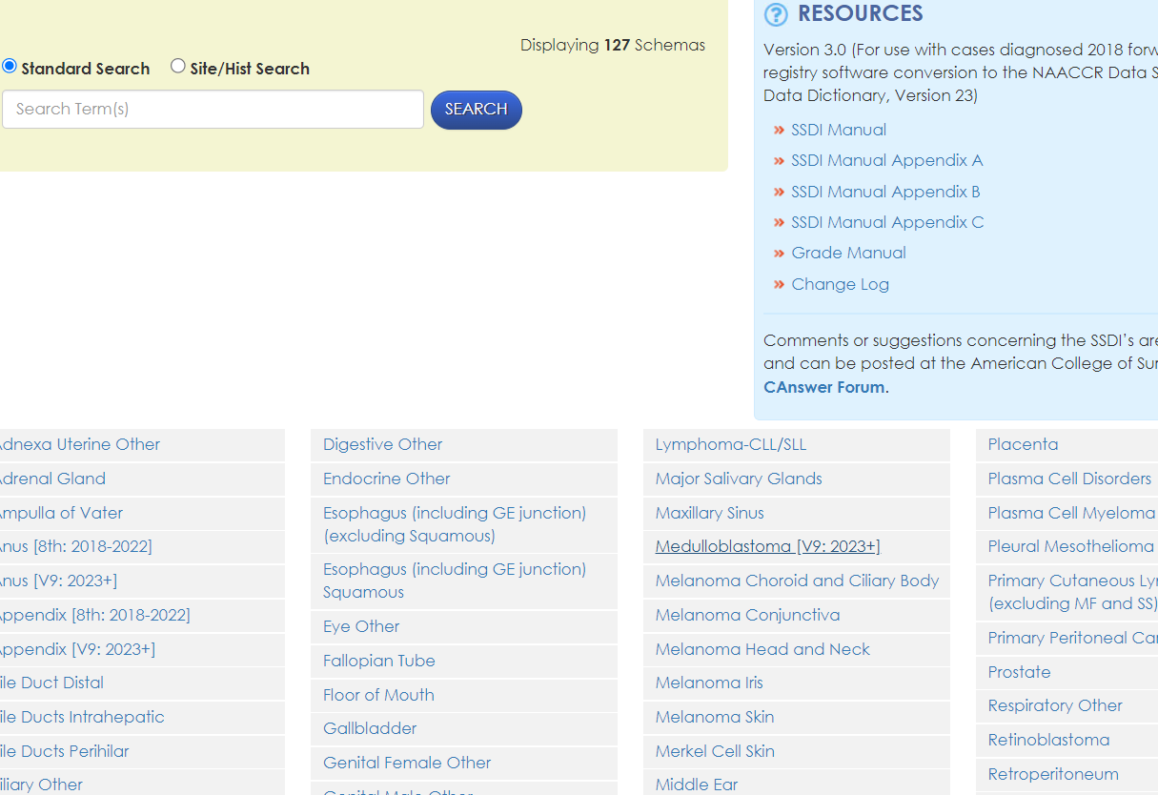
Cancer Schema List, SSDIs and Grade
https://apps.naaccr.org/ssdi/list/
Notes:
This site lists the current SSDIs for each primary cancer site and is also found under NAACCR. Type or click on the site for detailed information. A new Schema site has been added specifically for pediatric cases.

Slide 23
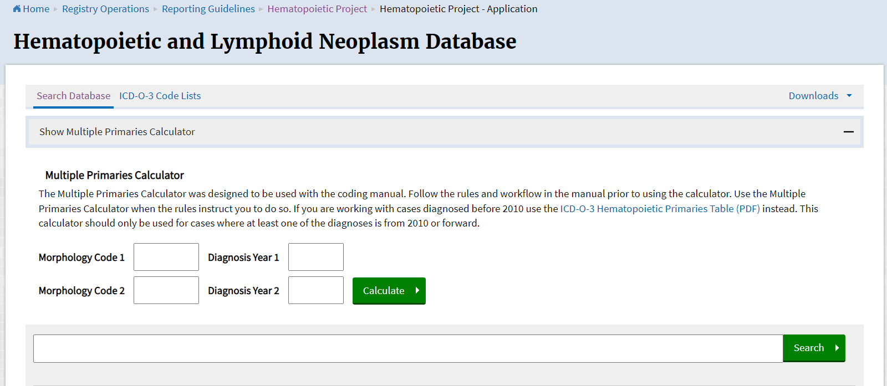
Hematopoietic and Lymphoid Database
Notes:
The Hematopoietic and Lymphoid Neoplasm Database is a handy tool to use in determining multiple primaries. However, do not ignore the Hematopoietic and Lymphoid Neoplasm coding manual. This is found on the SEER website in Registry Operations.

Slide 24
New Data Items for 2024
Length | Item# | Item Name | XML NAACCR ID | Parent XML Element | Section
1 | 86 | Geocoding Quality Code | geocodingQualityCode | Tumor | Demographic
14 | 87 | Geocoding Quality Code Detail | geocodingQualityCodeDetail | Tumor | Demographic
4 | 751 | Rx Hosp-Recon Breast | rxHospReconBreast | Tumor | Hospital Specific
4 | 1335 | Rx Summ-Recon Breast | rxSummReconBreast | Tumor | Treatment 1st Course
1 | 1975 | Derived Summary Grade 2018 | derivedSummaryGrade2018 | Tumor | Stage/Prognostic Factor
1 | 3964 | Brain Primary Tumor Location | brainPrimaryTumorLocation | Tumor | Stage/Prognostic Factor
Notes:
These are the new data items that will be collected on 2024 cases. The ones that primarily affect you are RX Hosp and RX Summ–Recon Breast and Brain Primary Tumor location.

Slide 25
New Data Items for 2025
Length | Item# | Item Name | XML NAACCR ID | XML Element | Section
1 | 1172 | Post Transplant Lymphoproliferative Disorder (PTLD) | ptld | Tumor | Stage/Prognostic Factor
5 | 1174 | PD-L1 Lung SSDI | pdl1 | Tumor | Stage/Prognostic Factor
Notes:
In adding more to the mixture, 2025 also has 2 new data items. Many older data items have been retired. Be sure to look for additional STORE changes listed on pages 29-35 of the manual.

Slide 26
Cancer Path CHART Initiative
2024 ICD-O-3 Site Morphology Validation list
Replaces the SEER Site/Histology validation list
Basis for newly added Primary site, Morphology and behavior code edits which check for valid, unlikely and impossible site/histology combinations
https://seer.cancer.gov/cancerpathchart/products.html
Notes:
The Cancer PathChart validation list is new and can be found on the SEER website. Read slide

Slide 27
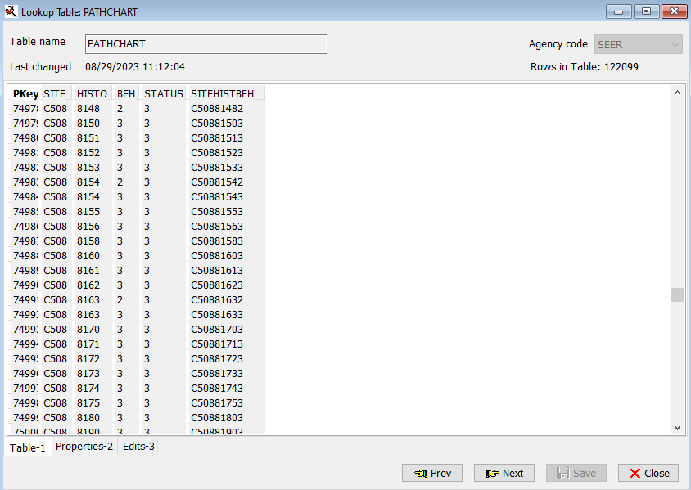
Cancer Path CHART in V24 Metafile
Notes:
Cancer PathCHART is a new table in V24 that checks sites and histology for correct combinations. This new table contains over 122,000 rows. The status of 1 is a valid combination. Status 2 means the combination is unlikely and status 3 is an impossible combination. In the example on the left, C000 lip has histology codes listed that are valid for that site. On the right, the histology codes listed for breast are identified as impossible by the number 3 in the status column. Edits will occur if the wrong site/histology combination is selected. This should increase the quality of coding.

Slide 28
MCR Website
Notes:
Our website contains a wealth of information. We are constantly updating and adding information. Soon we will have Zone design maps.

Slide 29
New Website Design
Updated Website in 2024 with move to College of Health Sciences
Notes:
In 2024, we redesigned our website. Some areas are still under progress. Jeff Steffens, ODS, updates our website, LinkedIn and Facebook accounts. We’ll keep our eyes and ears open to new suggestions for new improvements.

Slide 30
Training and Education
Notes:
We like to provide a mixture of educational opportunities.

Slide 31
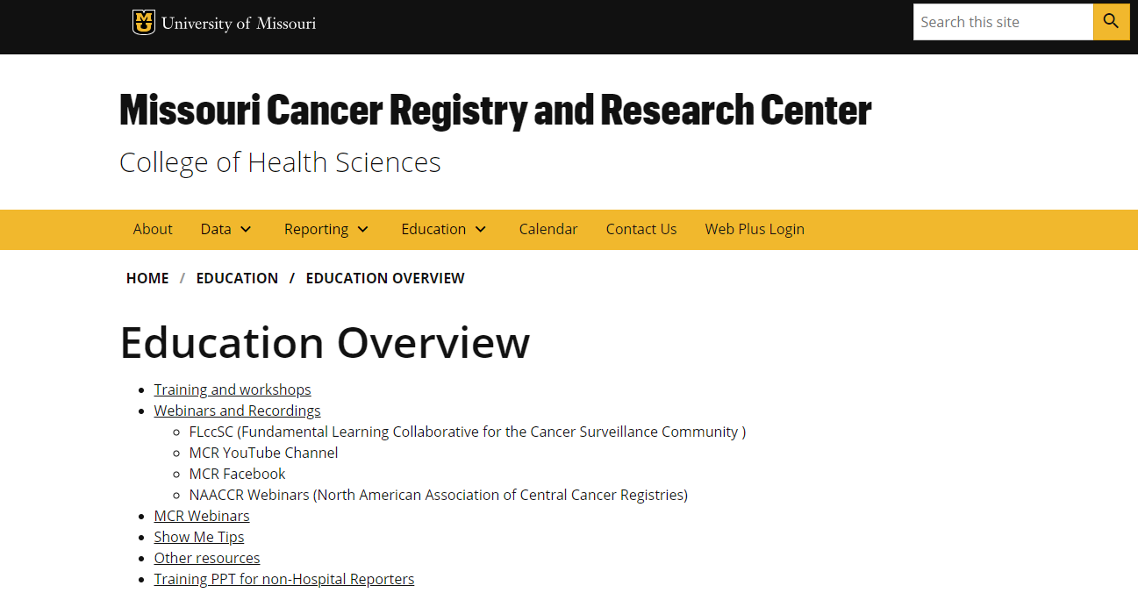
Educational Activities
https://medicine.missouri.edu/centers-institutes-labs/cancer-registry-research-center/education
Canvas Fundamentals of Abstracting Course
NAACCR Webinars
You tube videos
Show-Me-Tips
Abstracting Tips
ODS Training Guide
Notes:
This is the MCR Cancer Reporting Education page on our website. The Fundamentals of Abstracting Workshop can be found under Training and Workshops. The NAACCR webinars can be found under Webinars and Recording where they are posted to FLccSC. Educational videos produced by the MCR team can be found on the MCR YouTube channel. In addition, we publish quarterly Show-Me-tips, periodic abstracting tips and assisted with updating the NAACCR CTR training Guide.

Slide 32
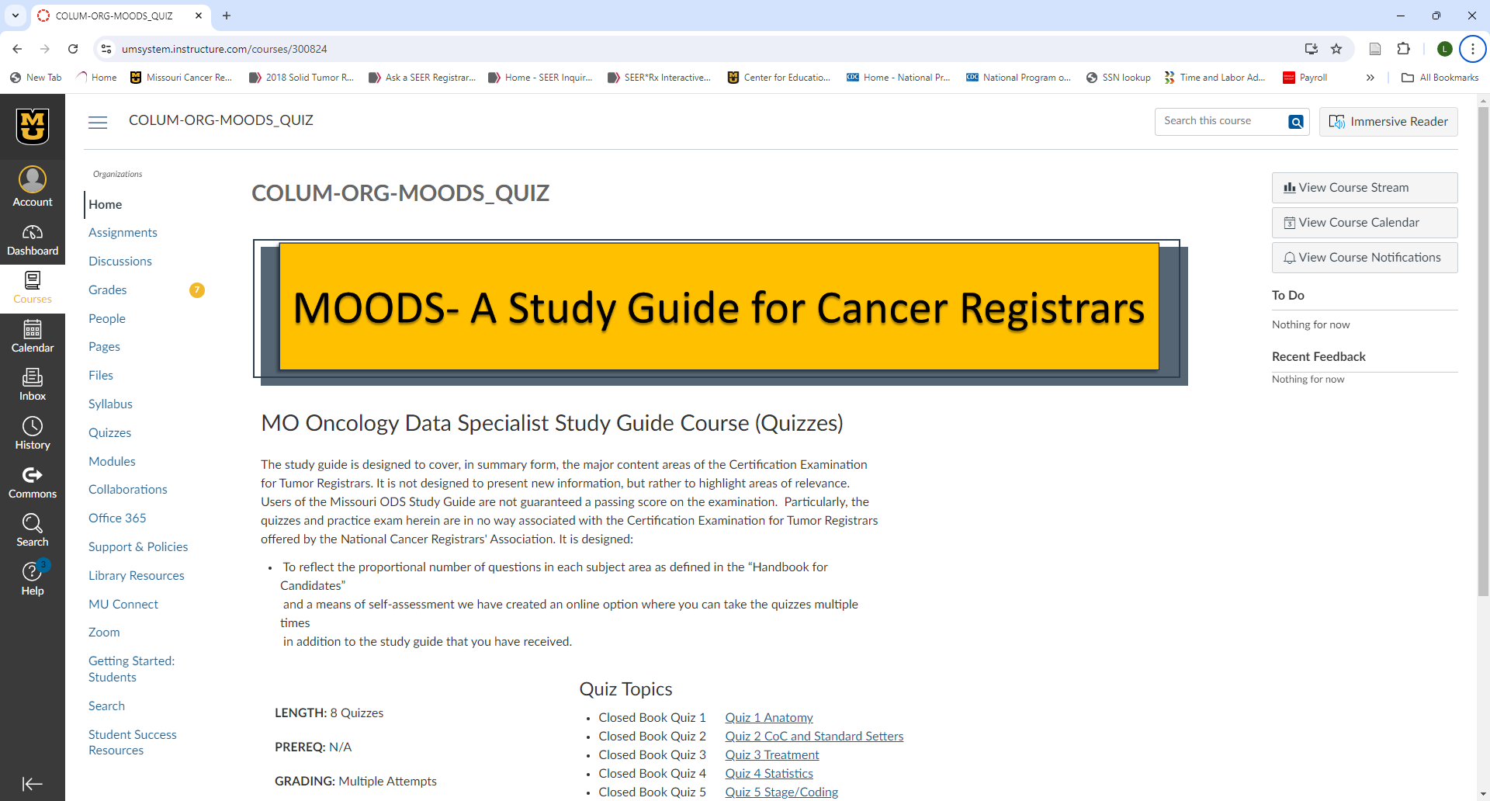
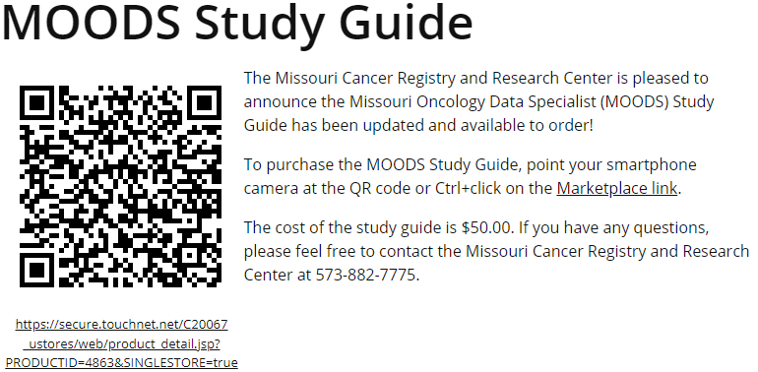
MOODS Study Guide
Missouri ODS Study Guide
Notes:
MCR is now responsible for updating and sending out the former MoSTRA study guide. The new name MOODS, stands for Missouri ODS Study Guide. We have developed on-line corresponding quizzes that go along with the study guide. Anyone who purchases the study guide will receive free on-line access to the quizzes which can be taken repeatedly.

Slide 33
Fundamentals of Abstracting Course
MCR offers the Canvas Fundamentals of Abstracting Course several times per year. For more information, contact me at lahf5p@health.Missouri.edu
Notes:
The Fundamentals of Abstracting Course was created during Covid which resides on the MU Canvas Platform. The course is updated at least once per year as changes are made by the standard setters. We have had great success with this course! The participants are from all over the US, and other countries. MCR plans to create a Cancer Surveillance course and a Cancer Registry Management course that can be taken individually or as an elective course through the University of Missouri.

Slide 34
YouTube Videos
Notes:
We keep adding more ingredients to make a successful MCR Soup. Several ODSs at MCR worked on these educational videos for YouTube. We most recently added the Vulvar Cancer and HPV video. We post 2 to 3 videos per year.

Slide 35
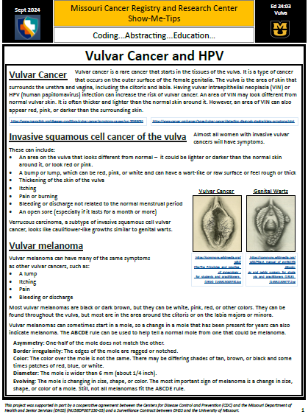
Show Me Tips
Notes:
MCR’s Education Coordinator, Babette Langeneckert, with the assistance of team members, publishes quarterly Show Me Tips that can be found in the monthly newsletter. The Show Me Tips contain important information like reading a cookbook to get the proper portions and cooking information.

Slide 36
Adding More to the Mix
Abstracting tips are included periodically in monthly updates.
NAACCR ODS training guide can be found under Grow Your Own ODS https://www.naaccr.org/recruitment-retention-toolkit/#1585662919736-d55864fc-2b40
Notes:
If the MCR QA team sees a particular trend in coding a data item incorrectly, we like to address it with an Abstracting Tip in the monthly newsletter. An updated ODS training guide can be found on the NAACCR website. Deb Smith is our very own personal information resource on both new and old topics.

Slide 37
And Now We Have Soup!
Notes:
The final MCR Soup is a collaboration of data collected from you - the case reporters, standard setter guidelines, and the MCR team. What is the end result other than a successful program? Data

Slide 38
DATA is like Dessert
MICA
One-Pagers
US Cancer Statistics Tool
Notes:
The data produced is like getting a piece of pie at the end of a project. Next, we will review MICA, MCR One-Pagers and the US Cancer Statistics tool.

Slide 39
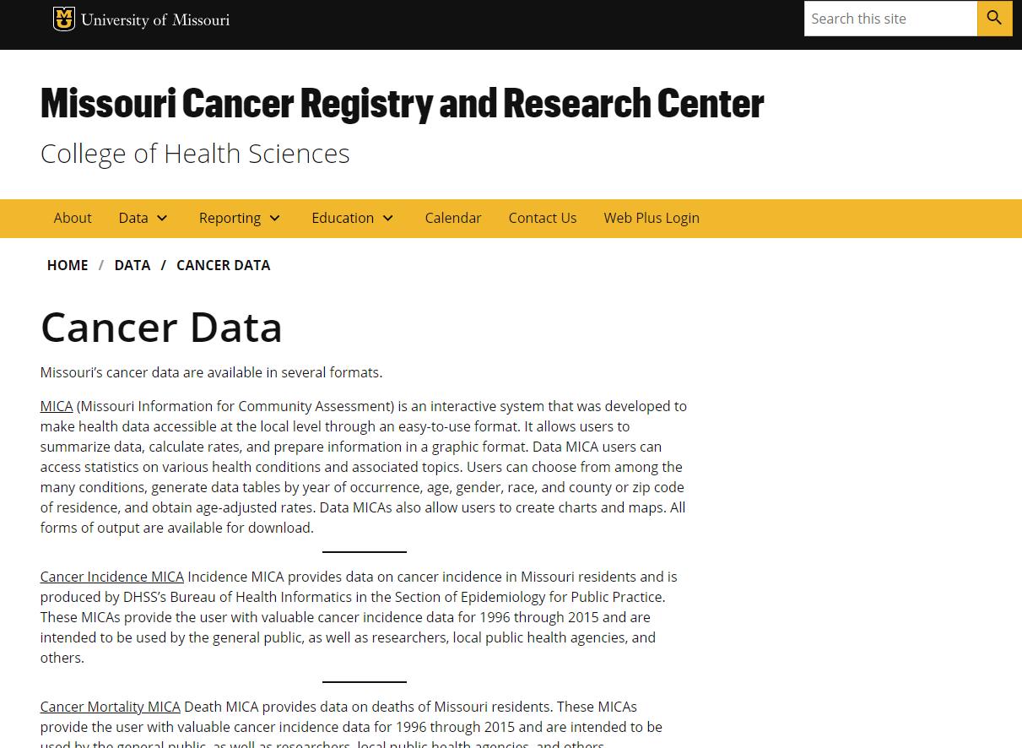
MICA
Missouri Information for Community Assessment
The link to MICA can be found on the MCR Website under Data/Cancer Data.
https://healthapps.dhss.mo.gov/MoPhims/MOPHIMSHome

Slide 40
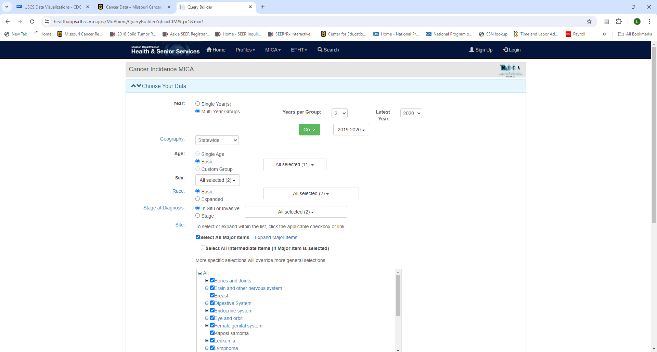
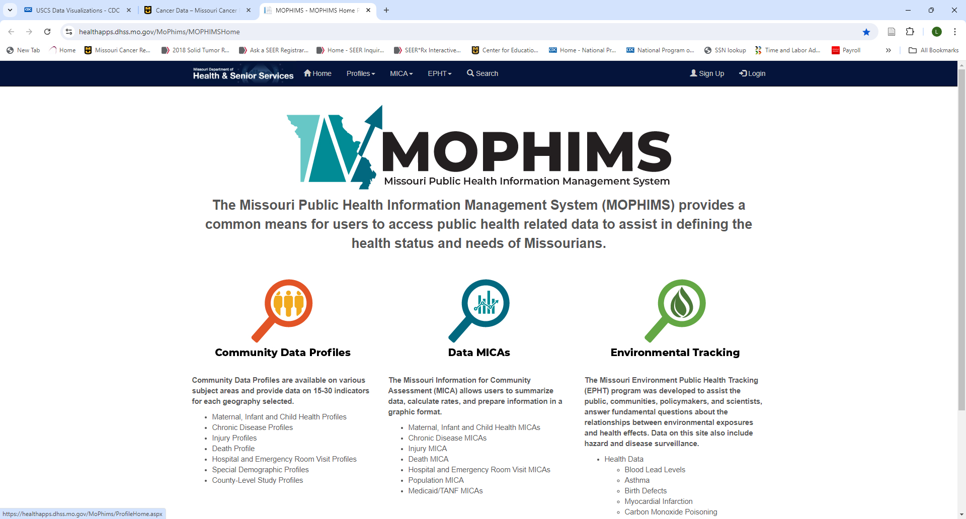
MICA
Notes:
This is the opening page of MICA. Click on Data MICAS to start your query. The right-hand side of the screen shows the parameters that can be selected. Results can be displayed in a table or graph.

Slide 41
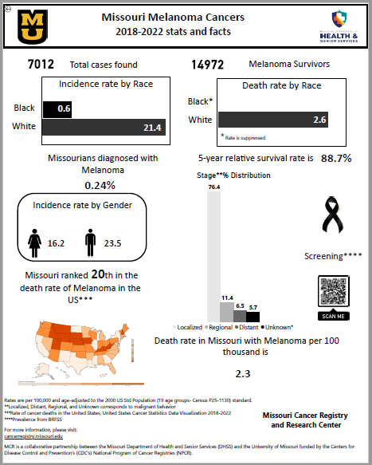
MCR One-Pagers
MCR has produced a number of one-pagers on top cancer sites in Missouri. This year we will have 12 one-pagers on the opening page of our website.
Notes:
The MCR one pagers were created by Vishwa Bhayani. Read slide They contain 2018-2022 statistical information.

Slide 42
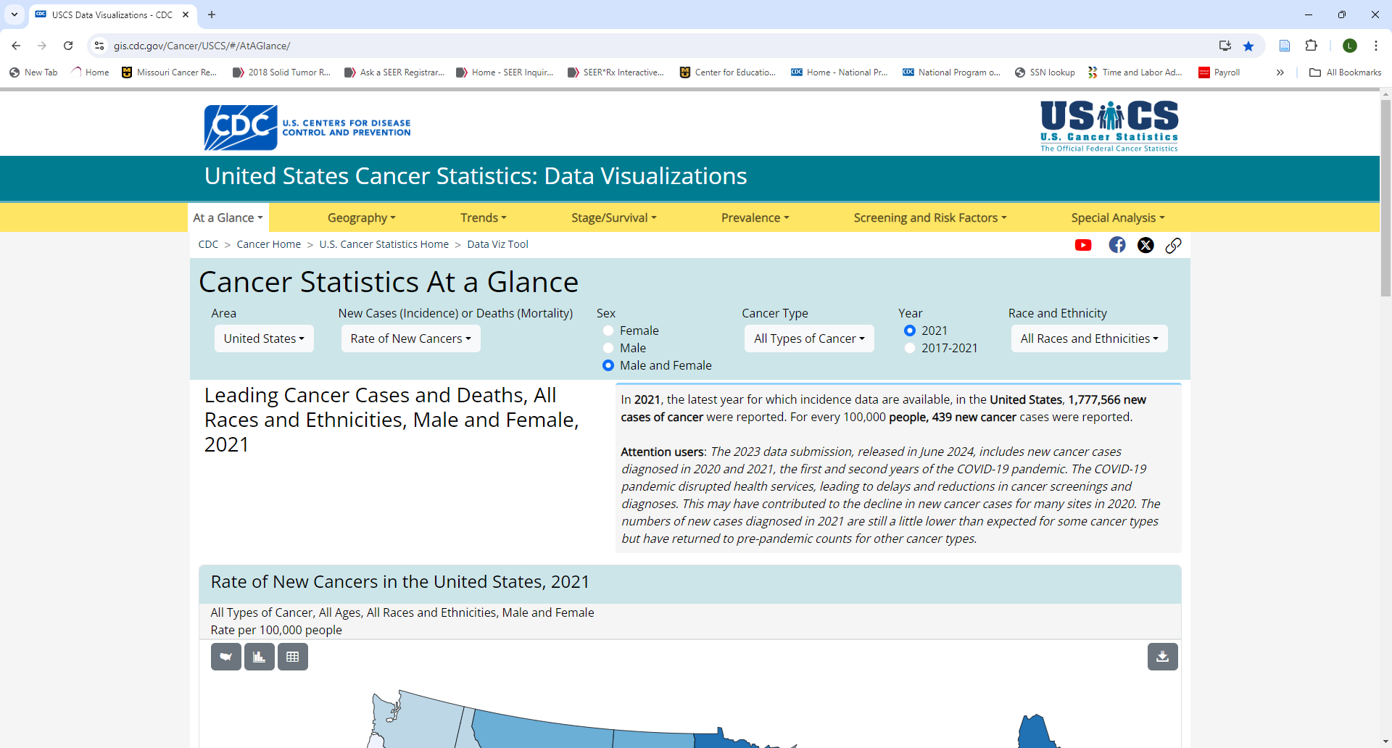
US Cancer Statistics
https://gis.cdc.gov/Cancehttps://gis.cdc.gov/Cancer/USCS/#/AtAGlance/r/USCS/#/AtAGlance/
The United States Cancer Statistics: Data Visualization page is also another method of researching cancer information for Missouri compared to other states. Reports can be run by geography, trends, stage/survival, prevalence and screening risk factors by clicking on the tabs.
The data was recently updated to include 2021 statistics.
Notes:
Read slide

Slide 43
Resources
NAACCR https://www.naaccr.org/
STORE https://www.facs.org/media/q4rnb3ck/store-2024-may-2023-final-05192023.pdf
SEER 2024 Solid Tumor Rules https://seer.cancer.gov/tools/solidtumor/
Missouri Cancer Registry and Research Center https://cancerregistry.missouri.edu/
US Cancer Statistics https://gis.cdc.gov/Cancer/USCS/#/AtAGlance/
MICA https://healthapps.dhss.mo.gov/MoPhims/MICAHome

Slide 44
Questions
????

Slide 45
Enjoy Your Lunch!

