Slide 1

Missouri Cancer Registry and Research Center updates and opportunities
Lucinda Ham, RHIA, ODS-C
Iris Zachary, PhD, MS, FAMIA, ODS-C
Missouri Cancer Registry and Research Center

Slide 2


Missouri Cancer Registry and Research Center
The Missouri Cancer Registry and Research Center (MCR) is supported in part by a cooperative agreement between the Centers for Disease Control and Prevention (CDC) and the Missouri Department of Health and Senior Services (DHSS) (NU5 8DP007130-02) and a Surveillance Contract between DHSS and the University of Missouri.
The contents of this presentation do noy represent the official views of the Centers for Disease Control and Prevention.

Slide 3
MCR Success and News
We have less staff but are doing well with the help of students from freshman to graduate students for the last two years
MCR was asked to showcase our student engagement at the CDC Program Director’s meeting
We are certified (GOLD), USCS certified and Registry of Excellence
We were visited as one of the registries that is leading the way in the DMI Data Modernization area
Missouri submits their data to the NCCR National Childhood Cancer Registry annually
MCR Health Data Maps go live by the end of the year
Notes:
Read slide

Slide 4
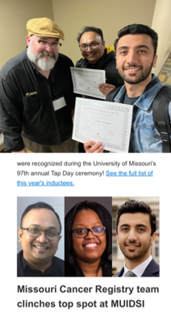
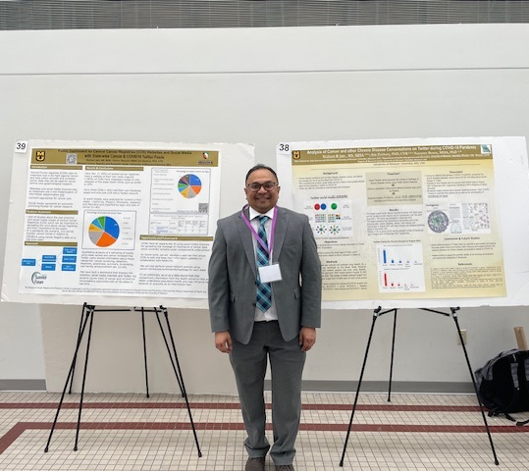
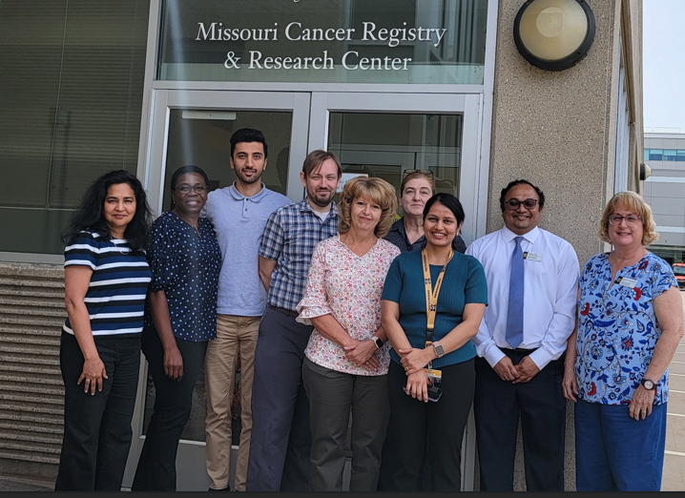
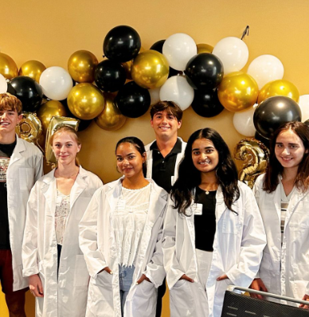
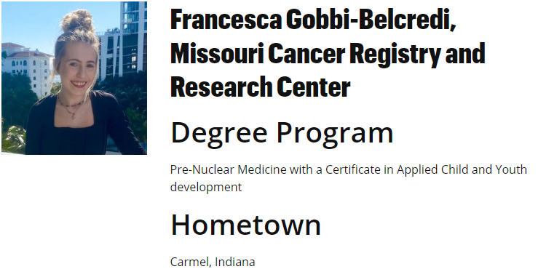
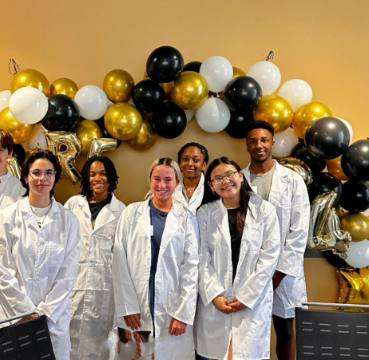
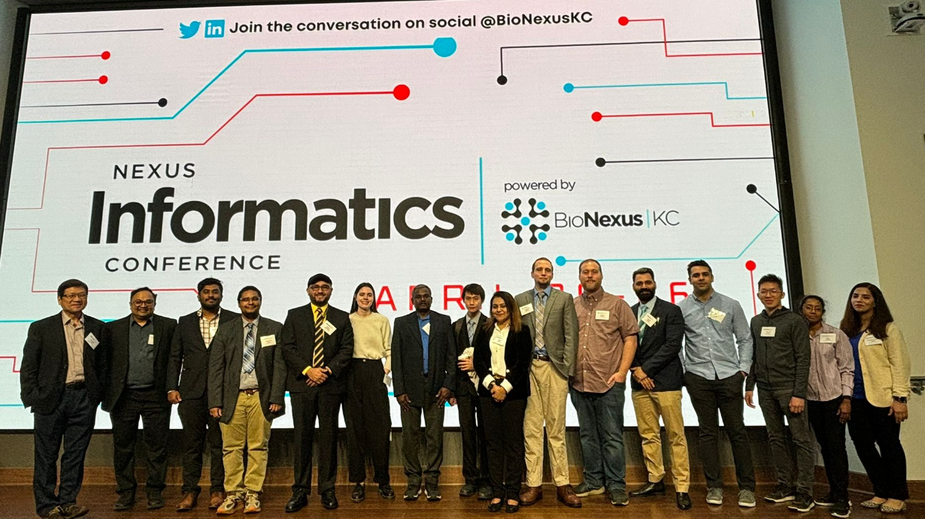
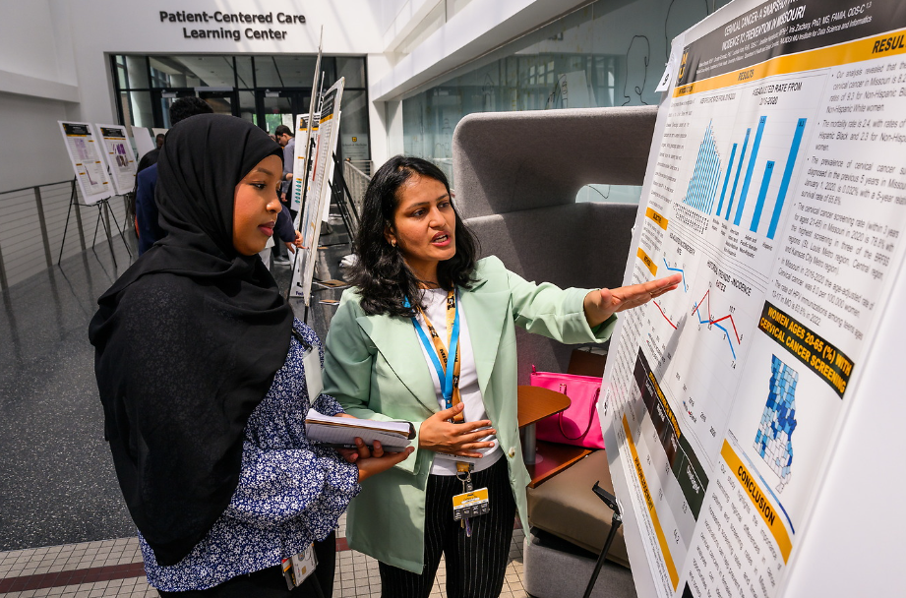
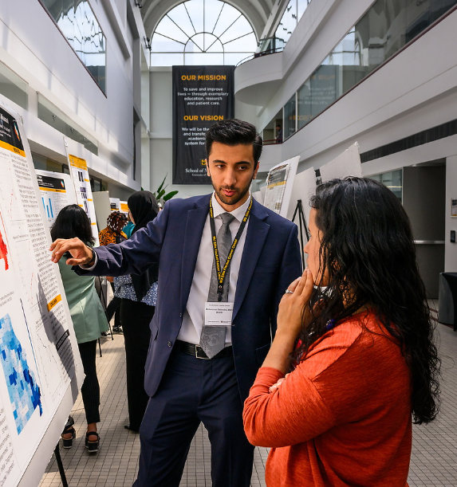

Slide 5
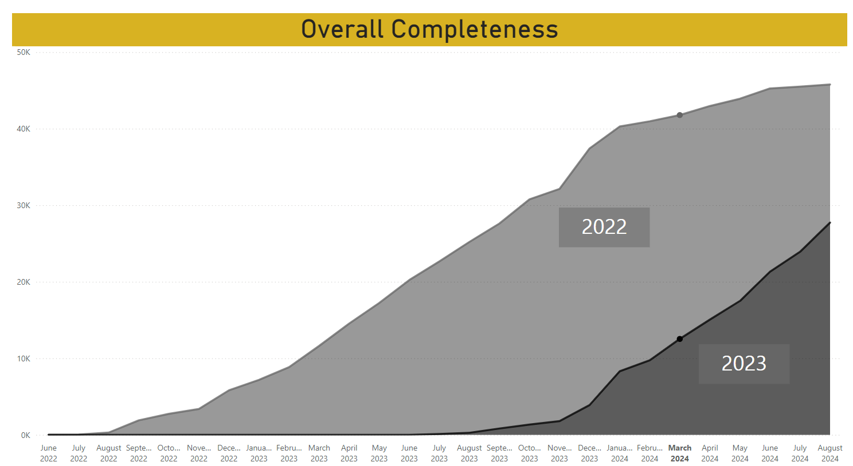
Accomplishments over two years
Thank You! You have submitted for 2022 + 2023 over 120,000 (total) cases that we have processed resulting in ~ 37,000 MO incidence cases per year
2022
100%
2023
74%
Notes:
https://app.powerbi.com/groups/me/reports/65a357a7-0b85-4b49-bef1-ec6a0817fa04/ff74f1dd58aaf13bafa9?ctid=e3fefdbe-f7e9-401b-a51a-355e01b05a89&experience=power-bi

Slide 6
Accomplishments over two years
Thank You! Your submissions enabled MCR to meet all requirements to meet GOLD Certification, USCS designation and Registry of Excellence.
MCR has presented the results from the Missouri data at five conferences and has presented over 20 posters and presentations at various venues
MCR was recognized at the last CDC site visit by CDC as one of the more advanced registries in the US

Slide 7
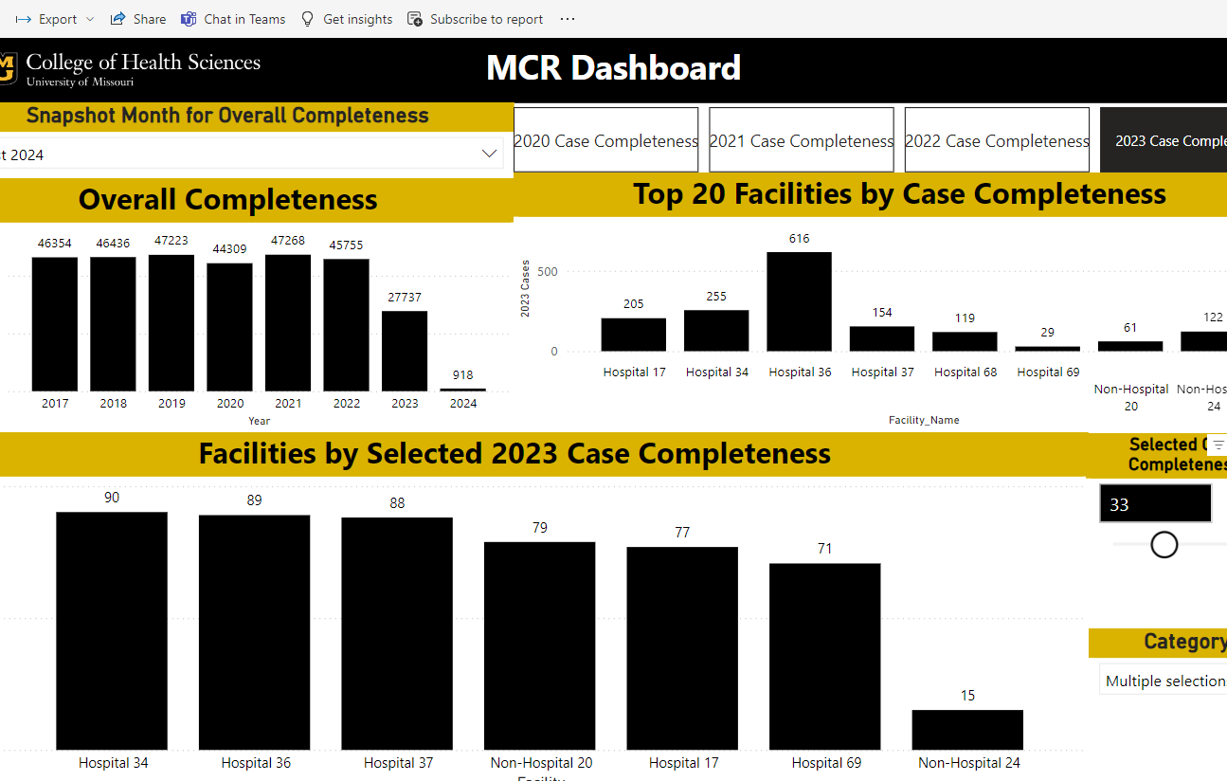
PowerBI Dashboard
We use PowerBI to monitor overall completeness throughout the year and look for trends in reporting.

Slide 8
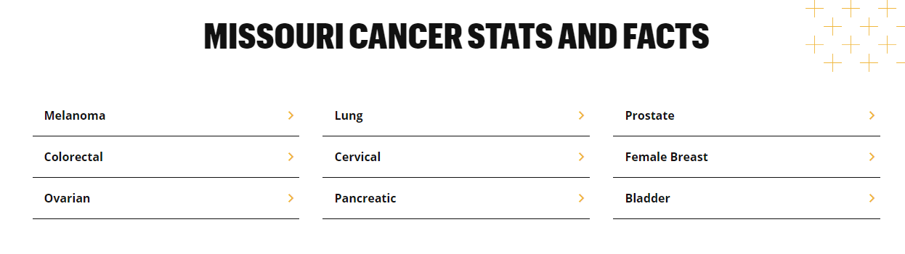
Missouri Stats and Facts
There were 174,376 new cases of cancer from 2017-2021.
There were 65,044 people who died of cancer from 2018-2022.
One Pagers on MCR websites:
Source - U.S. Cancer Statistics Working Group. U.S. Cancer Statistics Data Visualizations Tool. U.S. Department of Health and Human Services, Centers for Disease Control and Prevention and National Cancer Institute; https://www.cdc.gov/cancer/dataviz, released in June 2024.
Notes:
The mortality data is one year ahead
There were 174,376 new cases of cancer from 2017-2021.
For every 100,000 people 452 cancer cases were reported in Missouri.
There were 65,044 people who died of cancer from 2018-2022.
For every 100,000 people in Missouri, 161 died of cancer.

Slide 9
Missouri TOP 3 Sites 2017-2021
Male and Female
Breast
133.2
Prostate
97.3
Lung & Bronchus
61.4
Lung & Bronchus
75.2
Colon & Rectum
34.3
Colon & Rectum
44.3
Rate per 100,000 people
Source - U.S. Cancer Statistics Working Group. U.S. Cancer Statistics Data Visualizations Tool. U.S. Department of Health and Human Services, Centers for Disease Control and Prevention and National Cancer Institute; https://www.cdc.gov/cancer/dataviz, released in June 2024.

Slide 10
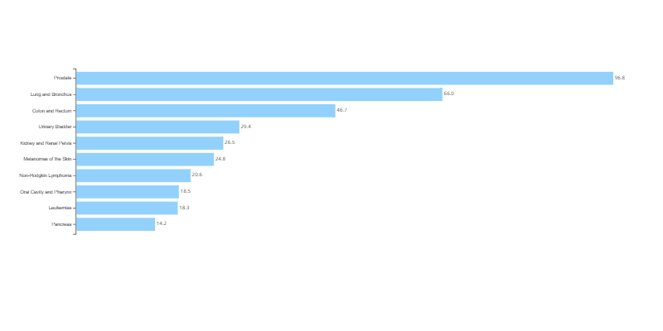
Top 10 Cancers by Rates of New Cancer Cases
Missouri, 2021, All Races and Ethnicities, Male
Rate per 100,000 men
Source - U.S. Cancer Statistics Working Group. U.S. Cancer Statistics Data Visualizations Tool. U.S. Department of Health and Human Services, Centers for Disease Control and Prevention and National Cancer Institute; https://www.cdc.gov/cancer/dataviz, released in June 2024.

Slide 11
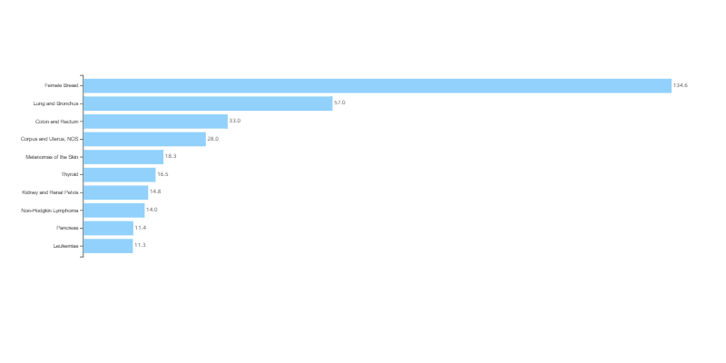
Top 10 Cancers by Rates of New Cancer Cases
Missouri, 2021, All Races and Ethnicities, Female
Rate per 100,000 women
Source - U.S. Cancer Statistics Working Group. U.S. Cancer Statistics Data Visualizations Tool. U.S. Department of Health and Human Services, Centers for Disease Control and Prevention and National Cancer Institute; https://www.cdc.gov/cancer/dataviz, released in June 2024.

Slide 12
Impact of Alcohol, Obesity and Smoking on Cancer Risk
A recent study looking at cancer deaths found that almost half were caused by preventable risk factors.
Almost 45% of cancer deaths are attributed to behavioral risk factors (smoking, alcohol, obesity)
The leading preventable risk factors that are attributed to cancer death were smoking, alcohol, and obesity.
Lancet The global burden of cancer attributable to risk factors https://www.thelancet.com/journals/lancet/article/PIIS0140-6736(22)01438-6/fulltext

Slide 13
Risk Factor Smoking Missouri
45.7%
39.2%
US Rate 41.3 %
US Rate 31.3 %
Source - U.S. Cancer Statistics Working Group. U.S. Cancer Statistics Data Visualizations Tool. U.S. Department of Health and Human Services, Centers for Disease Control and Prevention and National Cancer Institute; https://www.cdc.gov/cancer/dataviz, released in June 2024.

Slide 14
Risk Factor Alcohol Missouri
23%
15.2%
US Rate 18.9 %
US Rate 12.1 %
Source - U.S. Cancer Statistics Working Group. U.S. Cancer Statistics Data Visualizations Tool. U.S. Department of Health and Human Services, Centers for Disease Control and Prevention and National Cancer Institute; https://www.cdc.gov/cancer/dataviz, released in June 2024.

Slide 15
Risk Factor Obesity Missouri
35%
38.4%
US Rate 32.5 %
US Rate 34.3 %
Source - U.S. Cancer Statistics Working Group. U.S. Cancer Statistics Data Visualizations Tool. U.S. Department of Health and Human Services, Centers for Disease Control and Prevention and National Cancer Institute; https://www.cdc.gov/cancer/dataviz, released in June 2024.

Slide 16
Envisioning the next steps
Data Modernization MCR
Increase Use of Data
Make Education available and accessible through short courses
Please send us your suggestions

Slide 17
Questions?
Please reach out to our team at MCR
Email: umhshmimcr@missouri.edu
Phone Number: 573-882-7775
Website: www.missouricancerregistry.edu
Iris Zachary zacharyi@missouri.edu
Lucinda Ham Lahf5p@health.missouri.edu

Slide 18
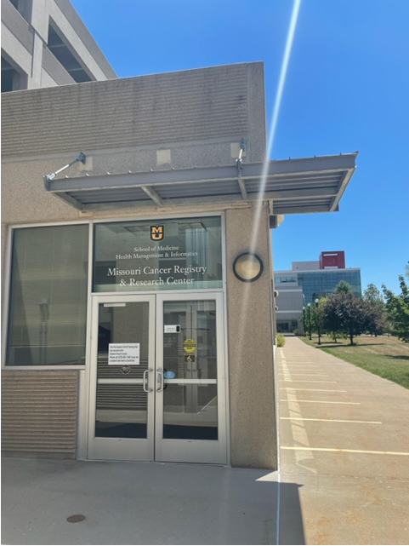
Come visit MCR
MCR website: http://cancerregistry.missouri.edu
Missouri Cancer Registry and Research Center - MU College of Health Sciences
Department of Public Health
University of Missouri

